Slide 1
INTERIM PROJECT-1
SMART SEARCH ENGINE

Slide 2
TEAM MEMBERS
YELISETTI KRISHNA TEJA (NET-ID : KXY200016)
SATYA SOMEPALLI (NET-ID : SXS190436)
SANJANA PENMETSA (NET-ID : SXP190149)
PREETHAM RAO GOTTUMUKULA (NET-ID : PXG210001)
HARSHITH RAVIPROLU (NET-ID : HXR180005)
SAKETH DASAVATHINI (NET-ID : SXD190016)
B MOUNIKA (NET-ID : MXB210007)
THOTA JAYASHREE SANTHOSHI (NET-ID : JXT210011)
SAI PRANAV REDDY DONTHIDI (NET-ID : SXD200125)
APUROOP PARAVADA (NET-ID : AXP210033)
YOGESH BALA (NET-ID : YXB200007)
SRINATH REDDY MAVILLAPALLY (NET-ID : SXM210047)
KIRAN DEVARAJ RAJ (NET-ID : KXR190038)
Class Diagram & Sequence diagram, Query-Processor
Usecase diagram & Sequence Diagrams
Pre-Processor, URL Collections &
Domain Modelling

Slide 3
INTRODUCTION
Smart Search Engine is a search engine where user inputs a query of word(s) and multiple URLs relevant to the query are displayed.
Here, firstly admin will have to collect a set of Wikipedia URLs specific to a topic like Cricket, Movies, Politics, etc. We have chosen ‘Movies’ as our topic/domain of search engine. Our search engine basically fetches URLs where user should search for something related to Movies.
Admin will have to collect multiple set of URLs for the results to be more efficient.
Admin has to store these URLs for the preprocessor to process it. Here, processing the data means scraping the data from web.
We store the scraped data in the form of document dictionaries which consists of keywords, relevant URLs and the index positions of the respective words in specific URL.

Slide 4
TOOLS/TECHNIQUES USED
We used multiple tools/techniques for our search engine:
Flask (Web framework)
Beautiful Soup (Web scraper)
Word Stemming (Words to their root form)
TF-IDF Vectorizer (Term frequency and Document frequency)
Page ranking using scores (To display URLs in the decreasing order of their relevancies)

Slide 5
BASIC FLOW
Preprocessor scrapes through all the URLs and saves a document dictionary of positions of all keywords present in all provided URLs by admin
Admin collects the URLs and saves it in a text file for the preprocessor
Admin then runs the preprocessor
Query_processor will stem the query and check the type of query(One word or multiple words)
Depending on the type of query, we will fetch all the URLs matched with stemmed word(s) present in the positions dictionary
User searches for a word or words
Display the URLs in the decreasing order of scores to the user
Calculate the scores of matched URLs(For page ranking)

Slide 6
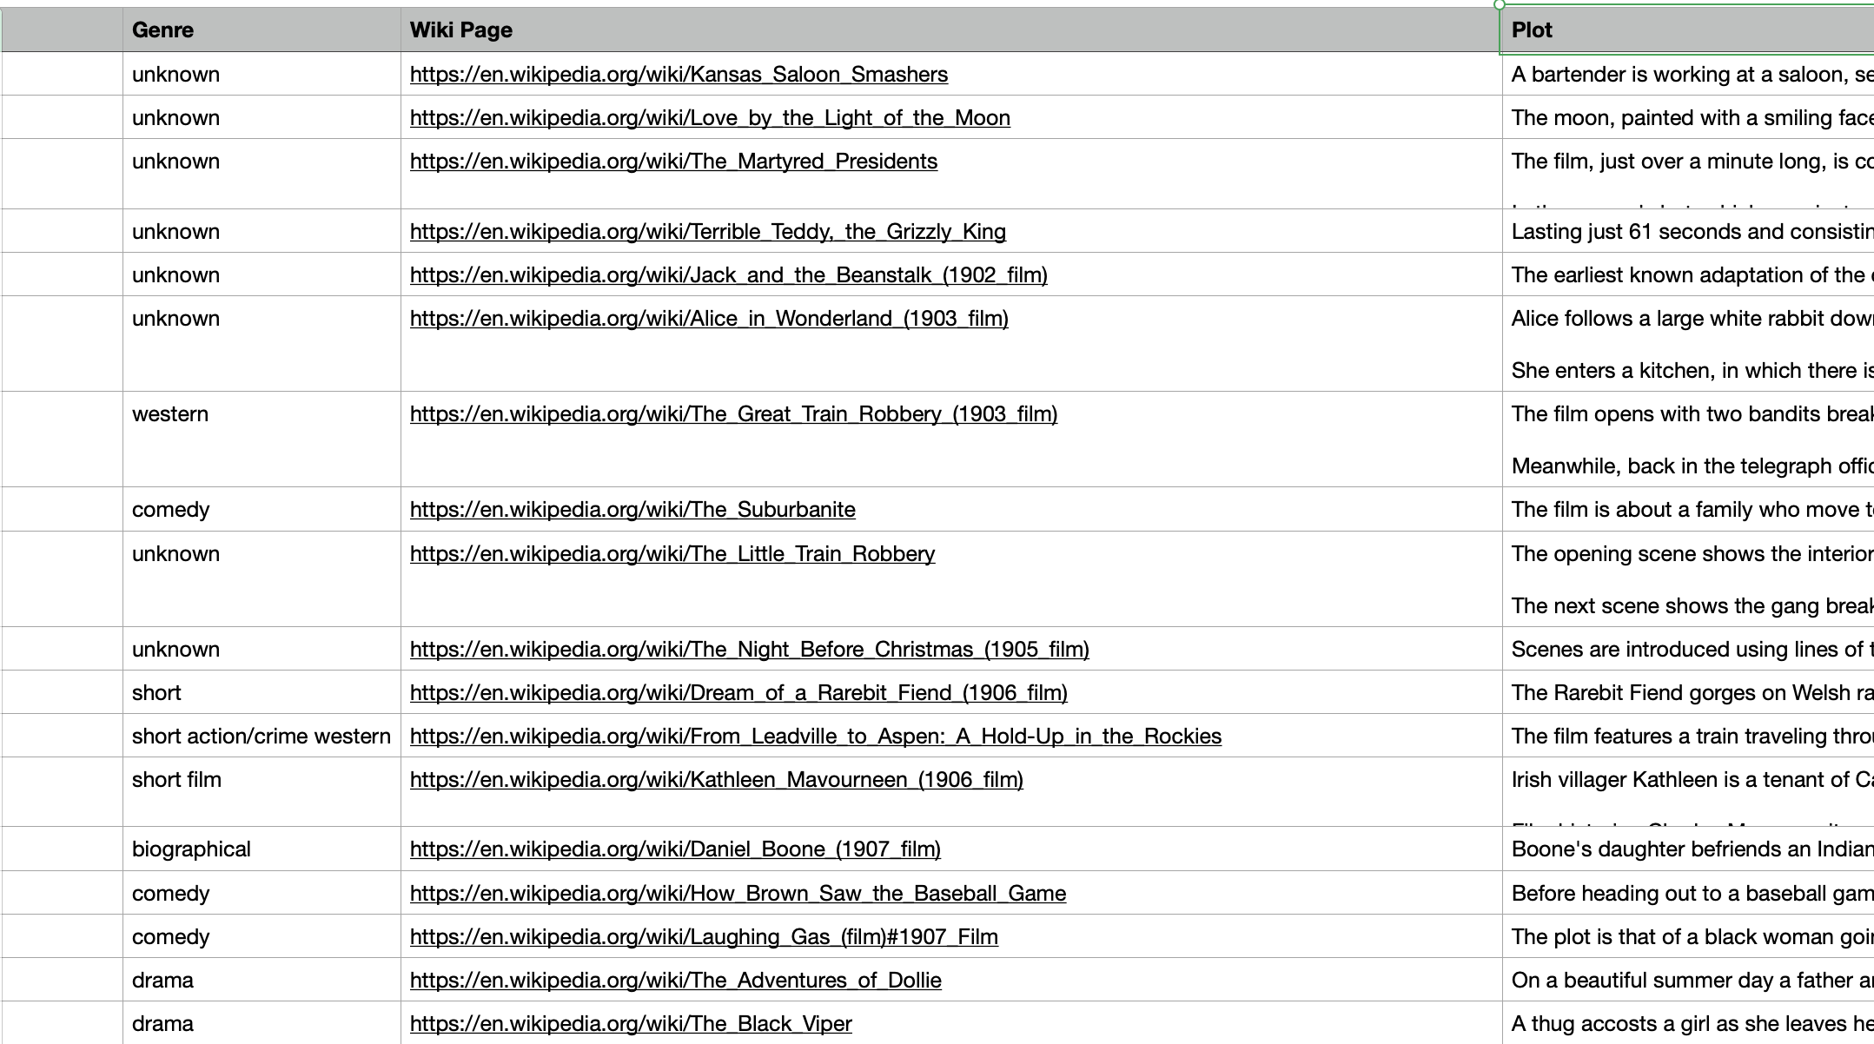
Admin will collect all the relevant URLs for the pre-processor and save it. Following is a screenshot of how the file looks :
Prep-processor will scrape these URLs

Slide 7
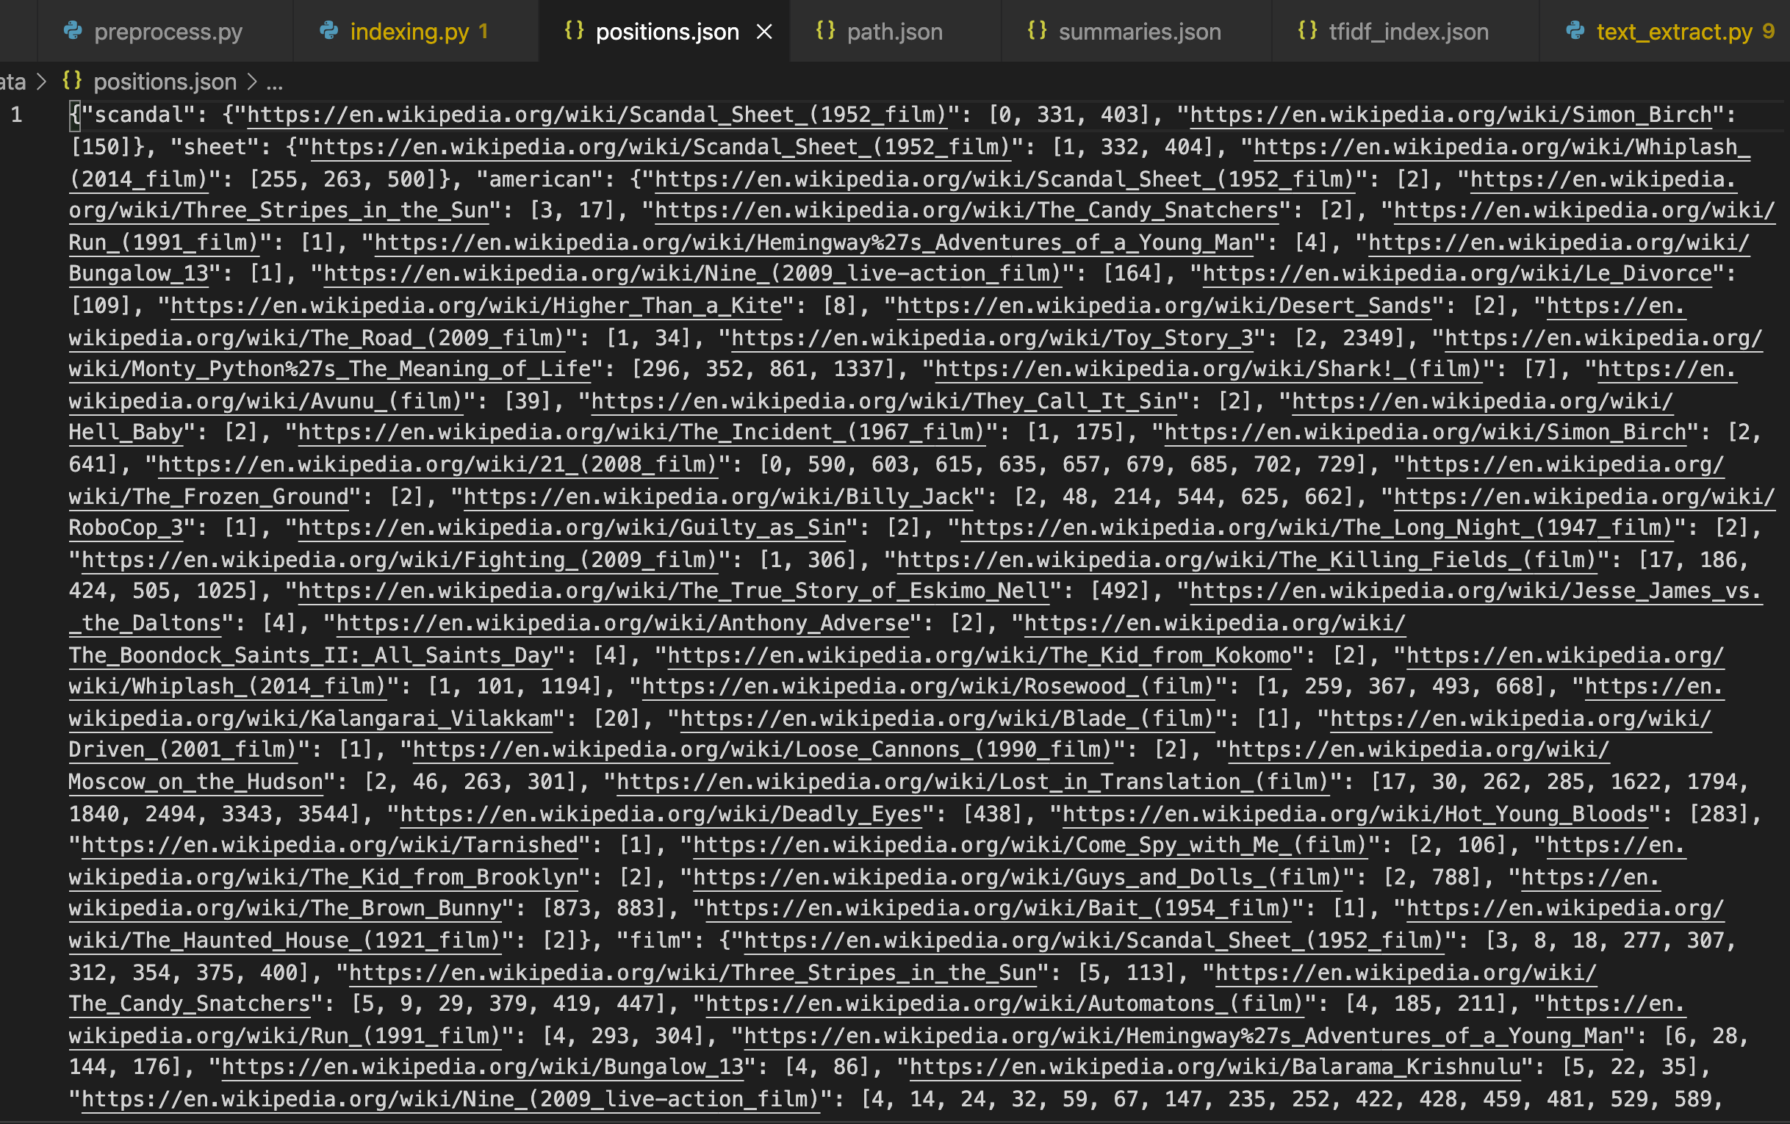
Admin will run the pre-processor and pre-processor will scrape all the URLs and give us an output file which looks like follows:

Slide 8
Following is an example document of the word ‘american’ saved in the previous file after scraping all the URLs provided by admin :
"american": {"https://en.wikipedia.org/wiki/Scandal_Sheet_(1952_film)": [2], "https://en.wikipedia.org/wiki/Three_Stripes_in_the_Sun": [3, 17], "https://en.wikipedia.org/wiki/The_Candy_Snatchers": [2], "https://en.wikipedia.org/wiki/Run_(1991_film)": [1], "https://en.wikipedia.org/wiki/Hemingway%27s_Adventures_of_a_Young_Man": [4], "https://en.wikipedia.org/wiki/Bungalow_13": [1], "https://en.wikipedia.org/wiki/Nine_(2009_live-action_film)": [164], "https://en.wikipedia.org/wiki/Le_Divorce": [109]}

Slide 9
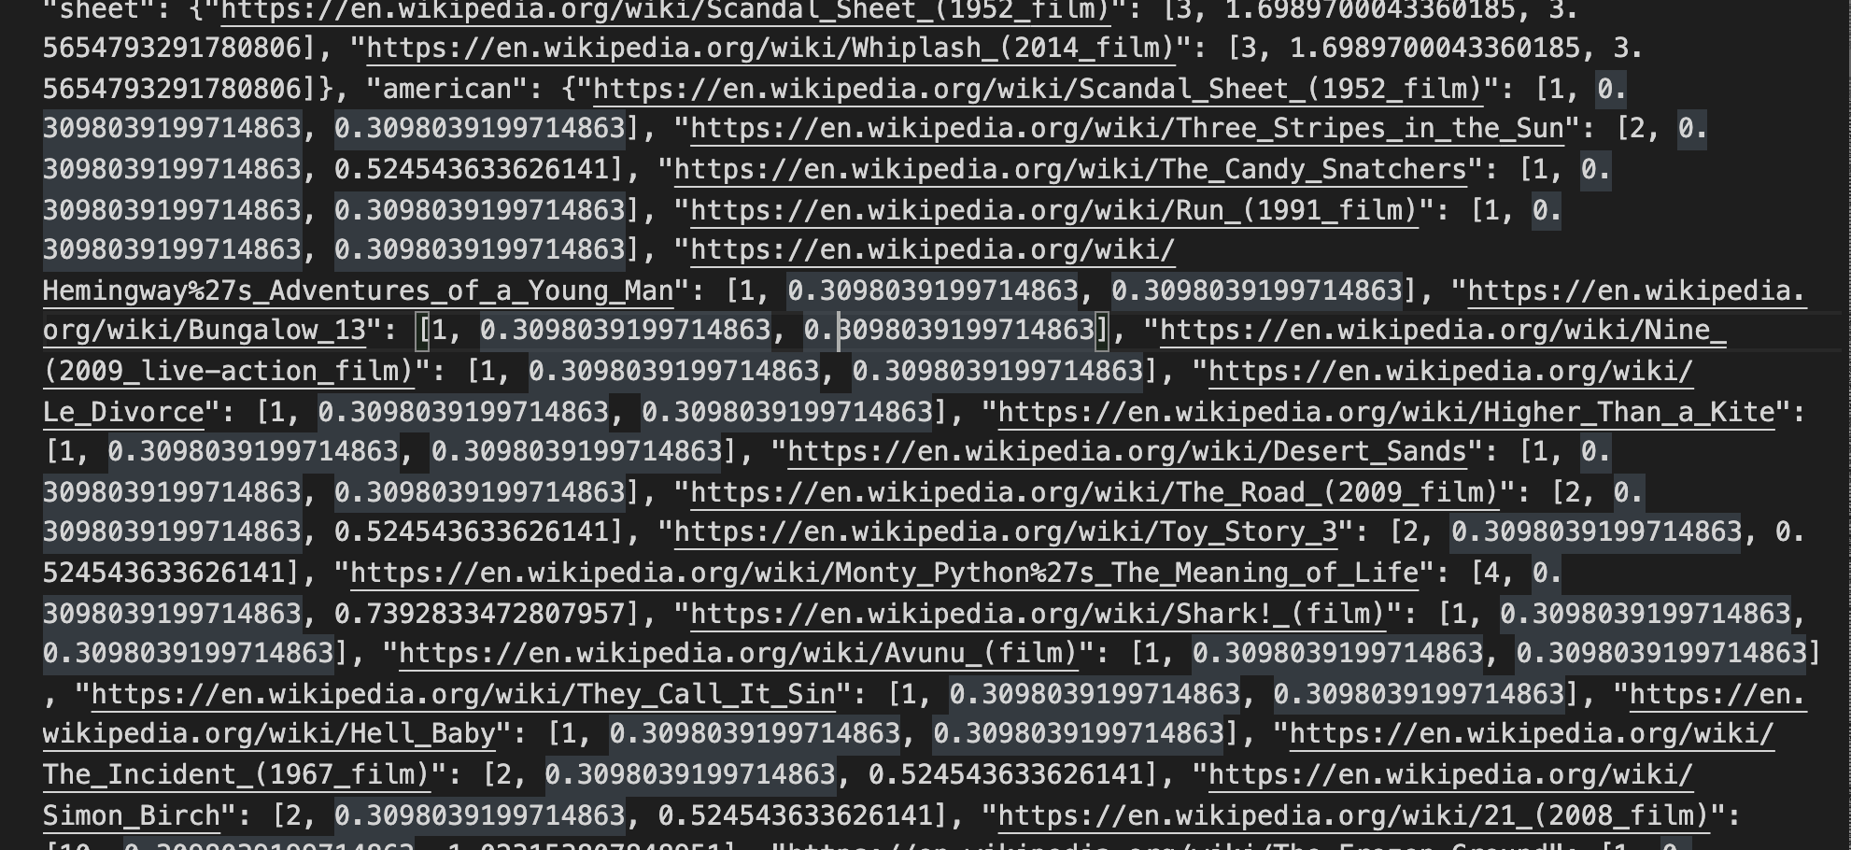
Following is the screenshot of document which will have TF-IDF scores of terms scraped in respective URLs in the form {TF, IDF, TF-IDF Scores} :

Slide 10
Following is an example document of the word ‘american’ saved in the previous file after scraping all the URLs provided by admin :
"american": {"https://en.wikipedia.org/wiki/Scandal_Sheet_(1952_film)": [1, 0.3098039199714863, 0.3098039199714863], "https://en.wikipedia.org/wiki/Three_Stripes_in_the_Sun": [2, 0.3098039199714863, 0.524543633626141], "https://en.wikipedia.org/wiki/The_Candy_Snatchers": [1, 0.3098039199714863, 0.3098039199714863], "https://en.wikipedia.org/wiki/Run_(1991_film)": [1, 0.3098039199714863, 0.3098039199714863], "https://en.wikipedia.org/wiki/Hemingway%27s_Adventures_of_a_Young_Man": [1, 0.3098039199714863, 0.3098039199714863], "https://en.wikipedia.org/wiki/Bungalow_13": [1, 0.3098039199714863, 0.3098039199714863], "https://en.wikipedia.org/wiki/Nine_(2009_live-action_film)": [1, 0.3098039199714863, 0.3098039199714863], "https://en.wikipedia.org/wiki/Le_Divorce": [1, 0.3098039199714863, 0.3098039199714863]}

Slide 11
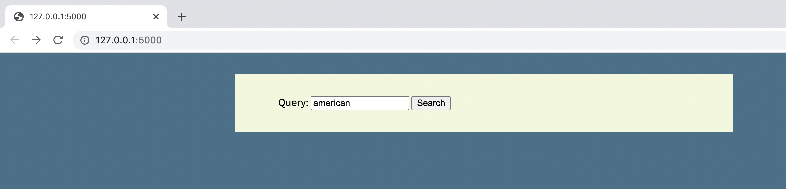
Sample-1 : Single word search
Here, we are searching for only a single word. So our search engine will return only those URLs which is in relevance to this word after stemming the word and matching it with the positions document saved by the pre-processor.

Slide 12
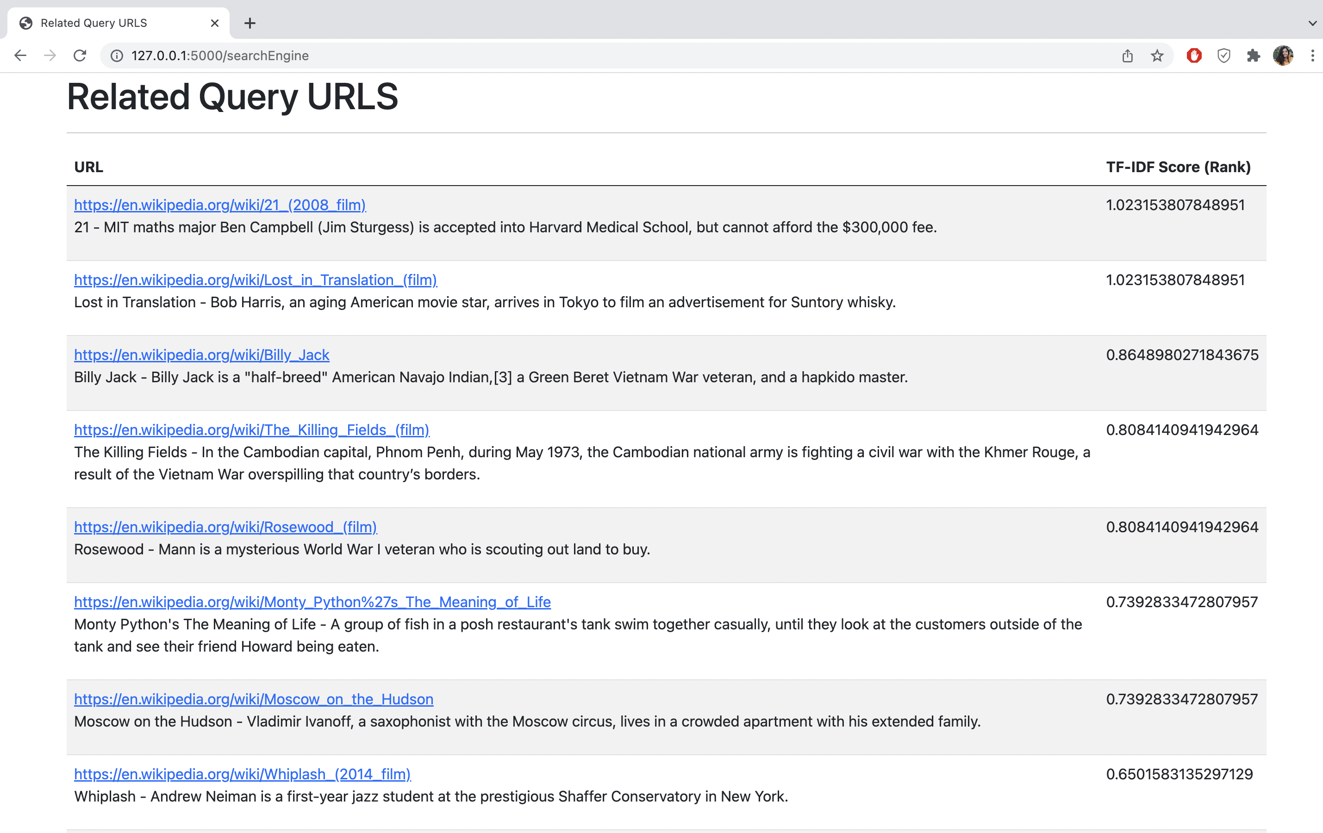
Sample-1 : Single word search Result
Results are displayed in decreasing order of TF-IDF Scores

Slide 13
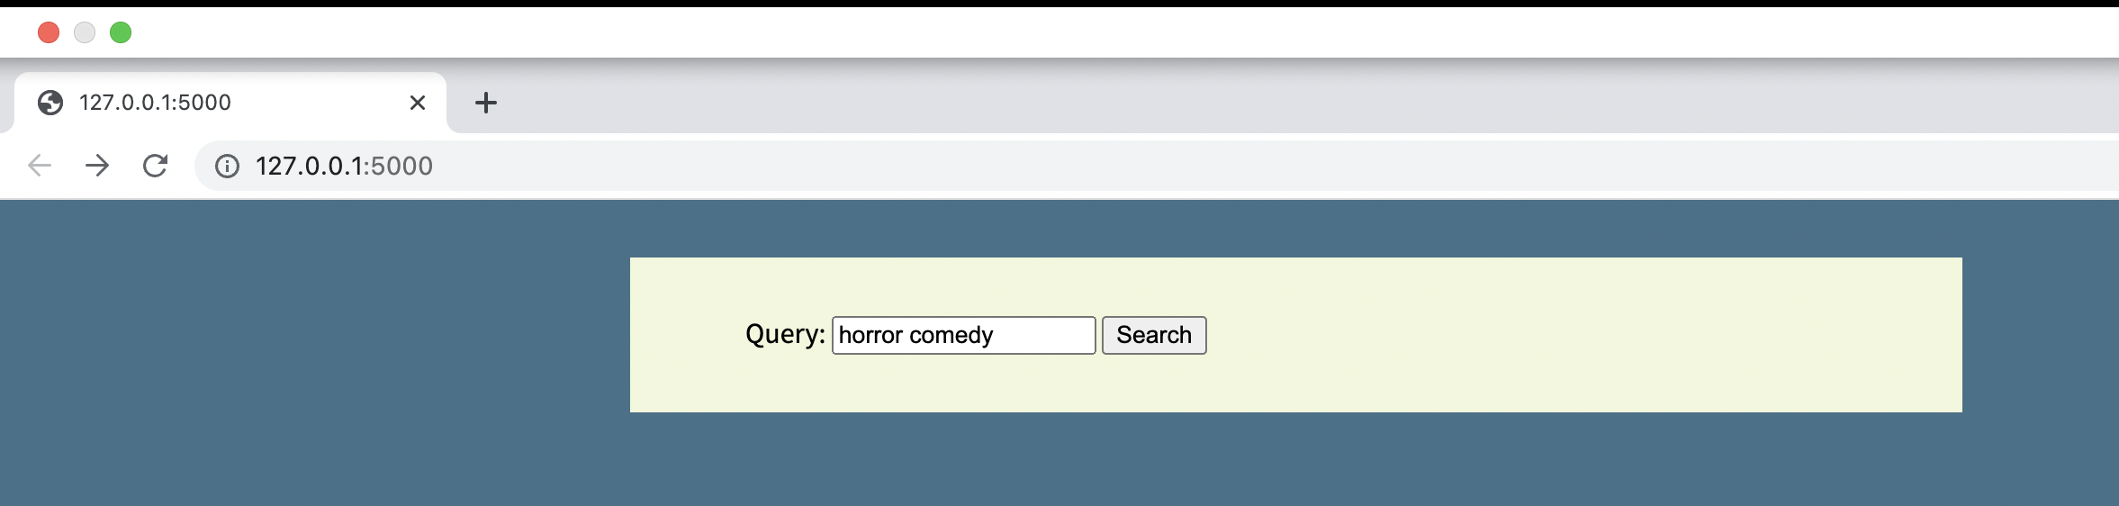
Sample-2 : Multiple words search
Here, we are searching for multiple words. So our search engine will return those URLs which will match with documents saved by pre-processor having both the words together in the same documents stemming the words.

Slide 14
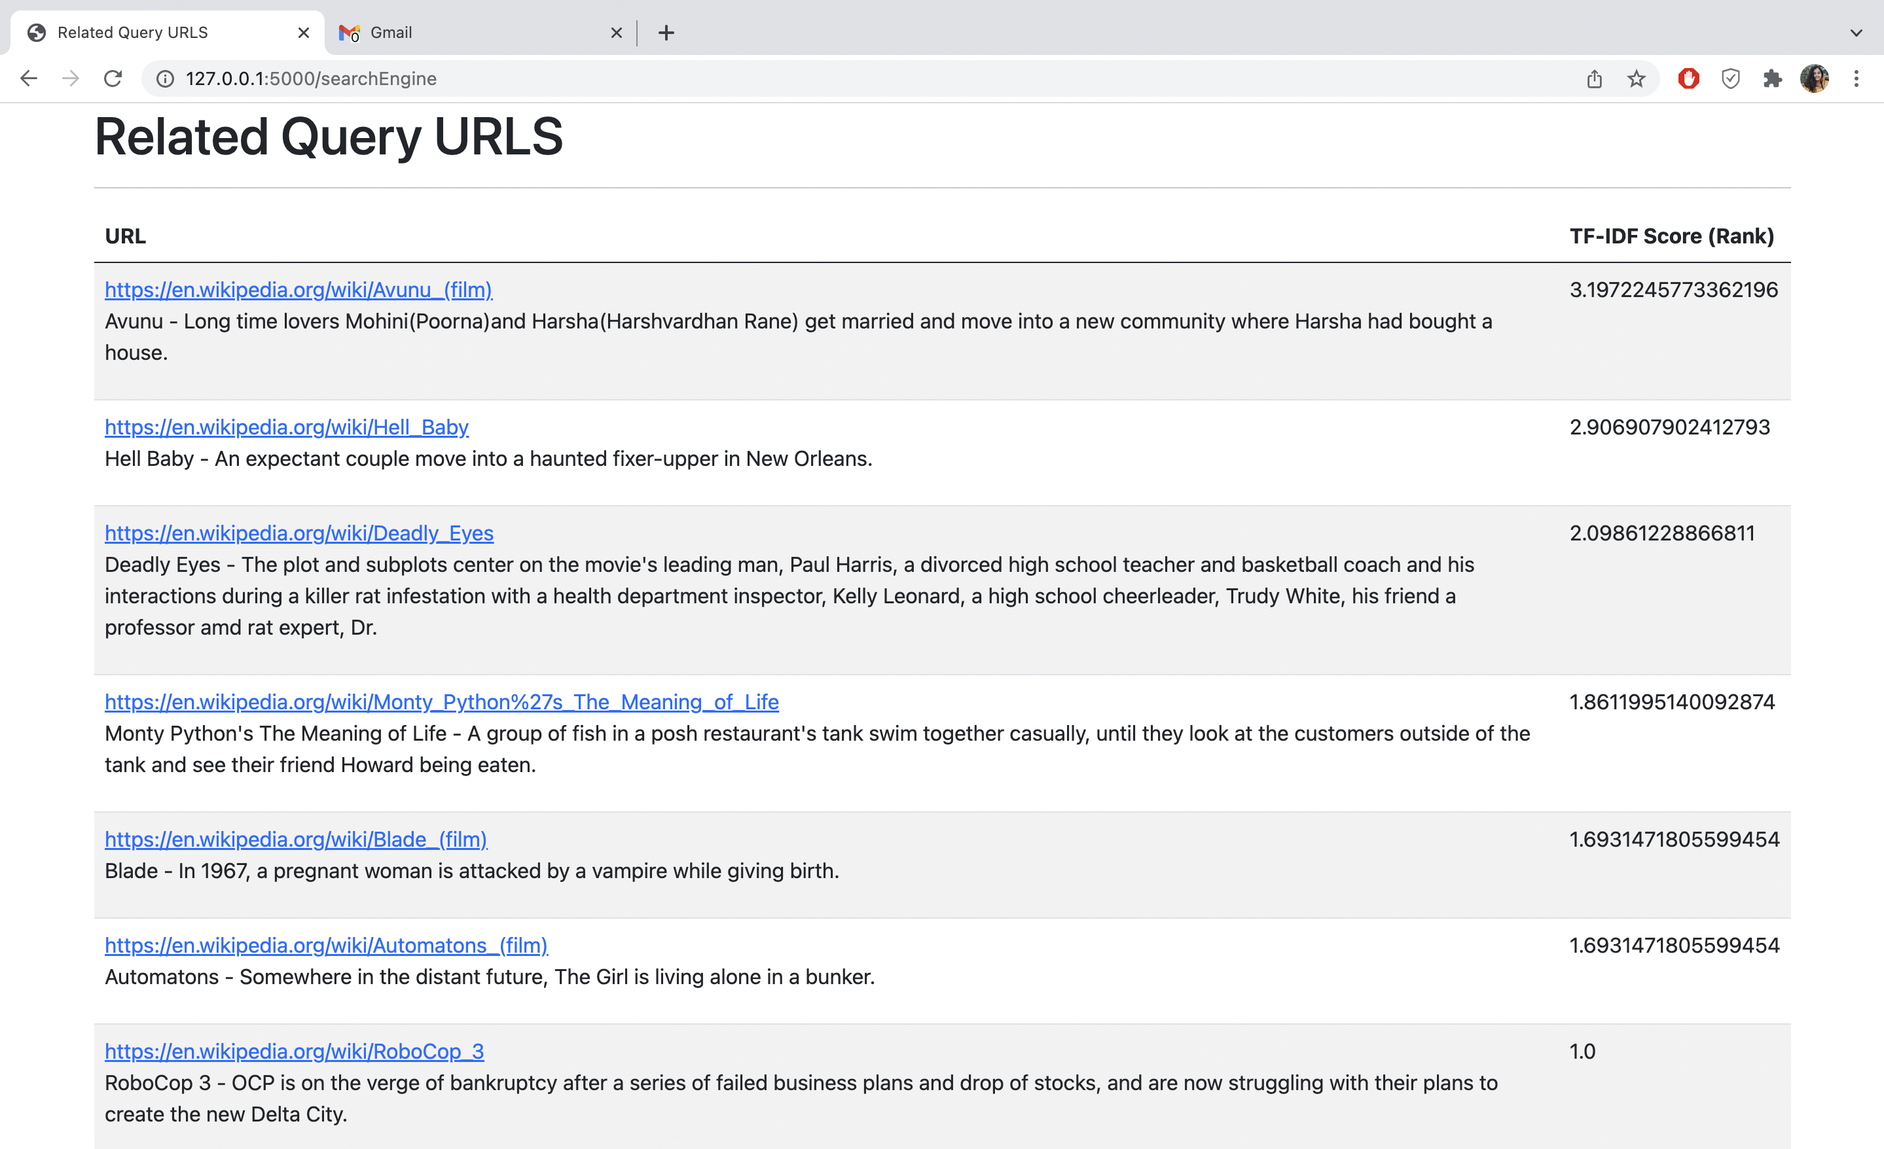
Sample-2 : Multiple words search Result
Results are displayed in decreasing order of TF-IDF Scores

Slide 15
UML DIAGRAMS
For our project, we have used the Star-UML software for drawing below listed type of UML Diagrams.
Usecase diagram
Sequence Diagram
Class diagram

Slide 16
USECASE DIAGRAM

Slide 17
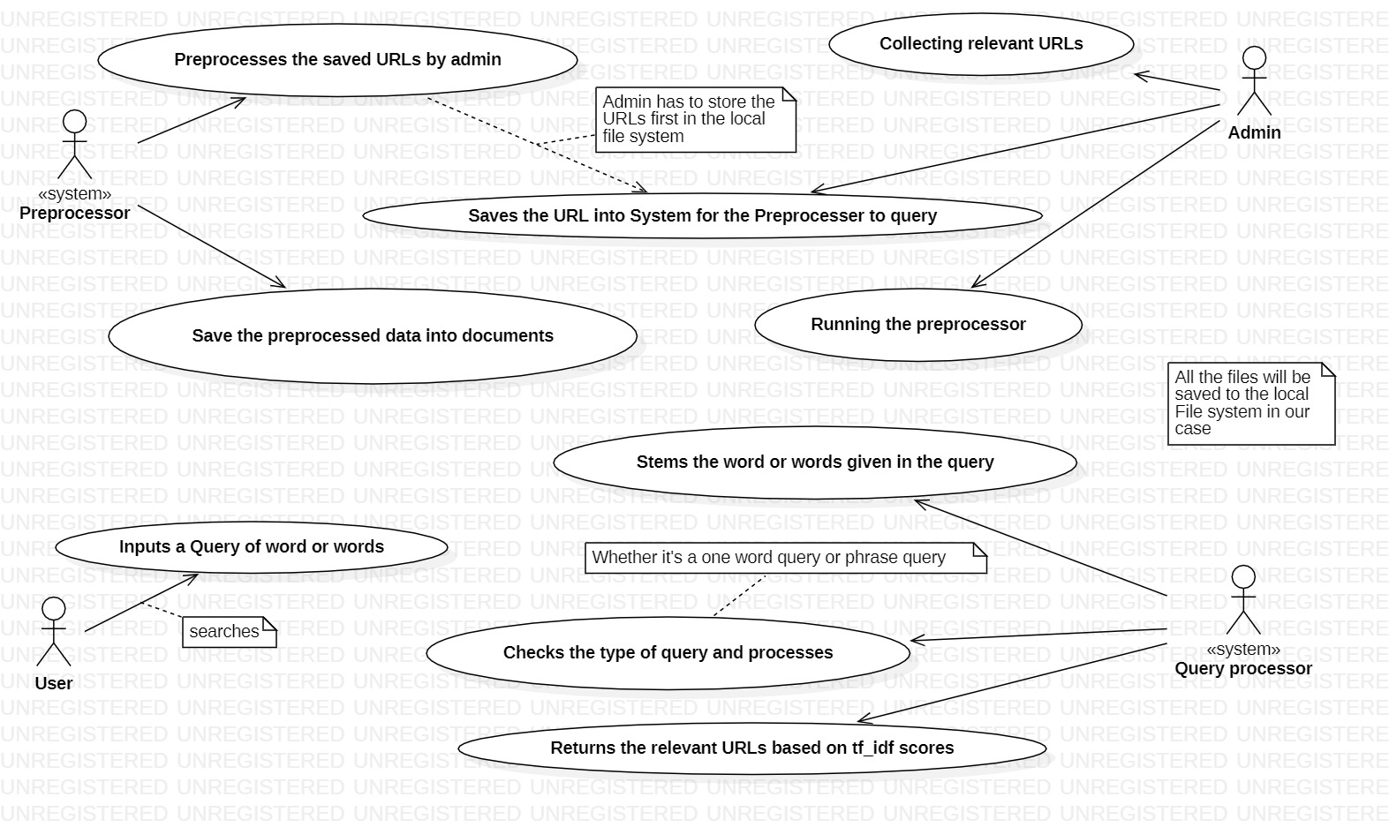

Slide 18
SEQUENCE DIAGRAMS

Slide 19
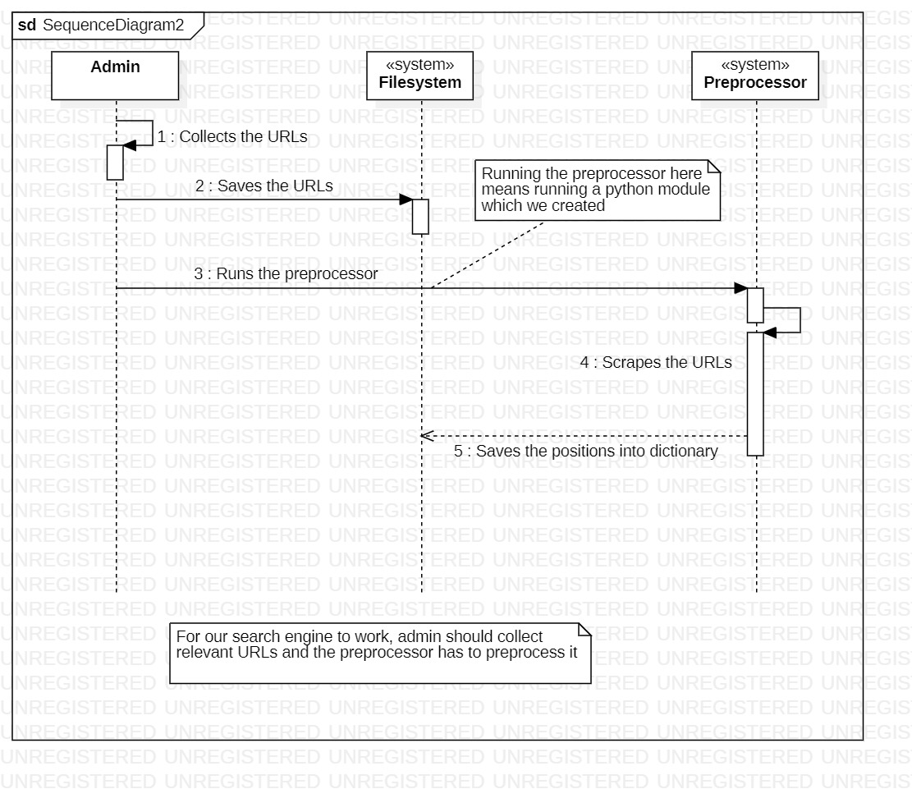

Slide 20
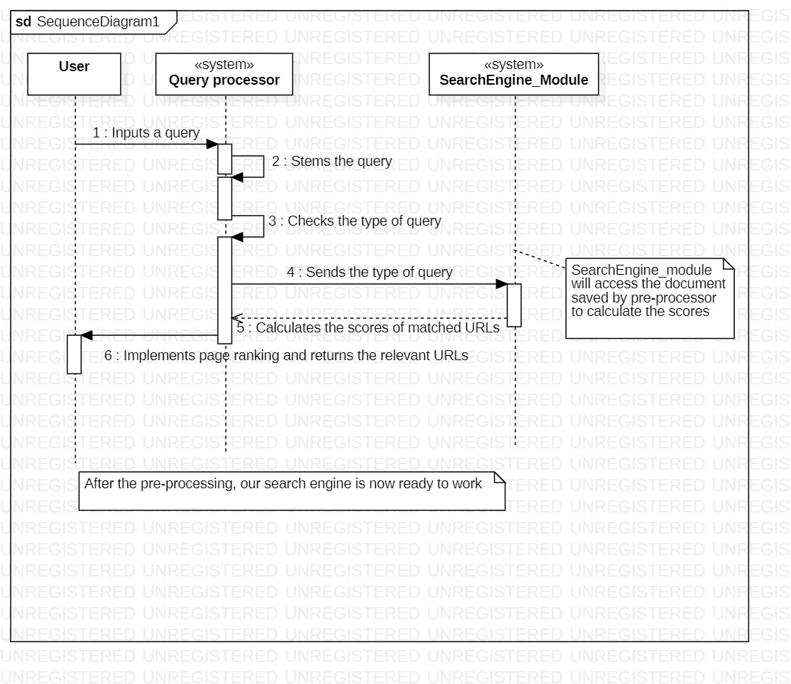

Slide 21
CLASS DIAGRAM

Slide 22
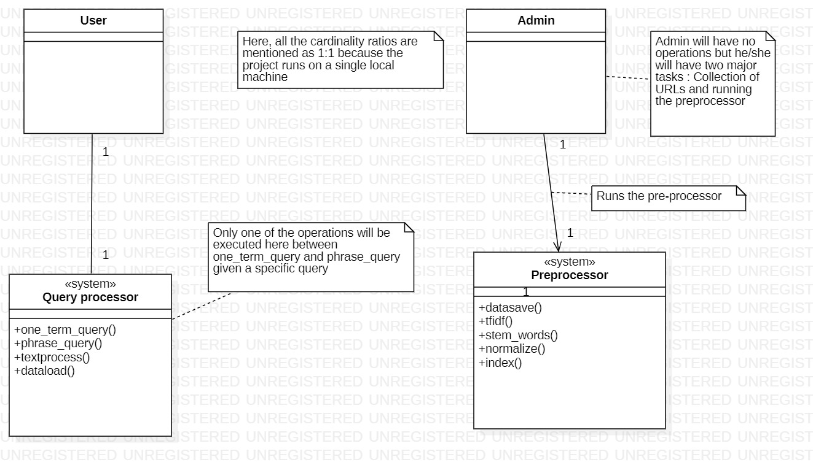

Slide 23
BUSINESS MODELLING,
REQUIREMENTS AND
DESIGN TOGETHER (SUMMARY)

Slide 24
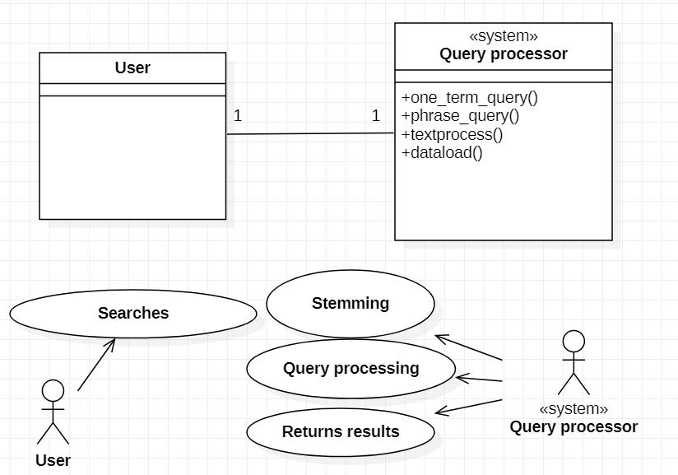
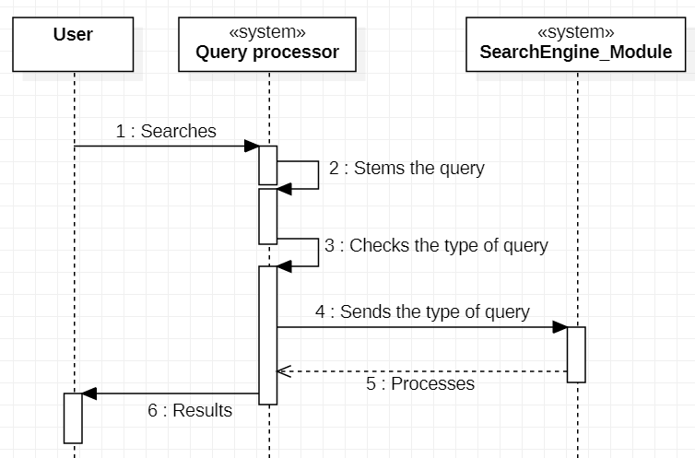
Business Modelling
Requirements
Design

Slide 25
WHAT NEXT?
For the next phase of this project we are planning to do the following :
UI Designing
Page-Rank Algorithm
UML diagrams
Collection of more URLs
Efficient implementation of Multi-phrase query

Slide 26
THANK YOU!
ANY QUESTIONS?

